Slide 1
REACT & REACT NATIVE
Daniel Kijkov, Vladimir Vanek, Josef Zavisek

Slide 2
Overview
introducing React & React Native
Notes:
Who has Windows and want to code with us, please raise your hands up
Who has MAC and doesn’t have XCode, install it right now (takes time to download)

Slide 3
Overview
introducing React & React Native
preparation of environment
Notes:
Who has Windows and want to code with us, please raise your hands up
Who has MAC and doesn’t have XCode, install it right now (takes time to download)

Slide 4
Overview
introducing React & React Native
preparation of environment
simple chat app from scratch
Notes:
Who has Windows and want to code with us, please raise your hands up
Who has MAC and doesn’t have XCode, install it right now (takes time to download)

Slide 5
What is REACT NATIVE?
library for building native mobile apps on Android and iOS
Notes:
Facebook aim is not to use exactly the same code on both platform rather then use the same technology for multiple platforms
Previously – you had to learn multiple languages to build Web, Backend, IOS, Android
You might be skeptical and you should – going of the path of platform can lead to pure user experience – React is great compromise and really amazing when used

Slide 6
What is REACT NATIVE?
library for building native mobile apps on Android and iOS
“Write once, run anywhere”
“Learn once, write anywhere”
Notes:
Facebook aim is not to use exactly the same code on both platform rather then use the same technology for multiple platforms
Previously – you had to learn multiple languages to build Web, Backend, IOS, Android
You might be skeptical and you should – going of the path of platform can lead to pure user experience – React is great compromise and really amazing when used

Slide 7
What is REACT?
library for building user web user interfaces
released 2013
goes against some practices that we were used to
Notes:
We cannot talk about REACT NATIVE without mentioning REACT
Let’s see what challenges React solves

Slide 8
Components in apps
Notes:
Look at the picture how it contains repeating patters, which can be wrapped into components

Slide 9
Components in apps

Slide 10
Components in apps

Slide 11
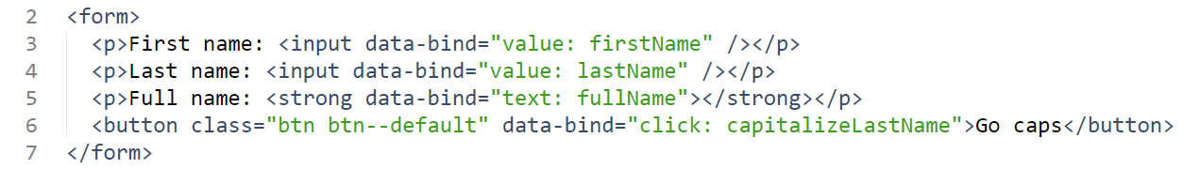
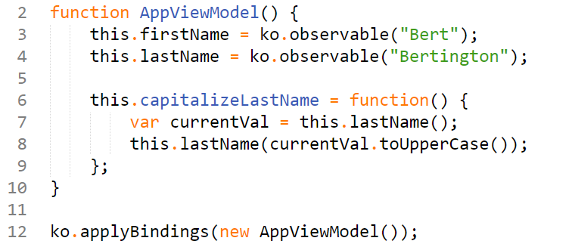
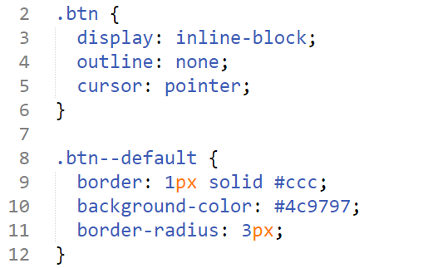
Common way in MVC frameworks
HTML template
Javascript
CSS
Notes:
Multiple files used for one thing, applications became really UNPREDICTABLE and very complex
We are cutting these things because of technology concerns not because of our needs
This can become really messy when the projects gets bigger
Code should be modular and a module should be responsible for one thing only, when we find module that manages two different parts of the application than you should separate those two things - React goes different way
React introduces web components - everything is done in COMPONENT-BASE architecture
Knows how to render itself, how it acts on actions, you can even embed style
In practical use it appears more handy
You give data into component and you get render result back

Slide 12
When trying to change unpredictable code
Notes:
You know the feeling when you don't trust your code

Slide 13
Issues with MVC libraries
Notes:
We want to ADD A NEW MESSAGE
Another problem with existing MVC frameworks is that they often re-render whole parts of page even though don’t have to
And they are usually tightly coupled with the DOM

Slide 14
Issues with MVC libraries
Notes:
Typical MVC framework do heavy aggressive re-rendering of views
When you changed the data you had to re-render completely the amount of views and components that depend on that data, because you didn't know to what elements they are tight to
Another thing in which React is different - other frameworks are very bound to DOM

Slide 15
Issues with MVC libraries
Notes:
Virtual DOM - react calculates minimal set of changes when going from the current UI to next UI
This makes it suitable for native as well

Slide 16
React components
Notes:
Virtual DOM - react calculates minimal set of changes when going from the current UI to next UI
This makes it suitable for native as well

Slide 17
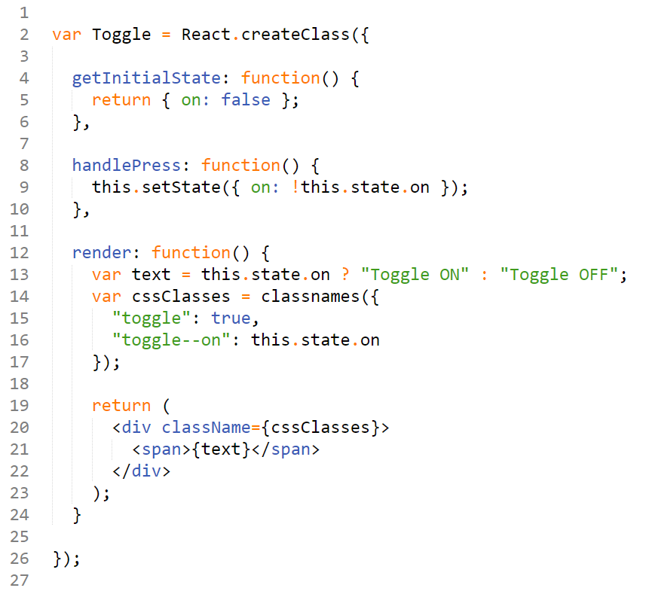
What does the component look in REACT?
Notes:
JSX syntax – can include XML like elements directly in the code
RENDER method – declarative
GETINITIALSTATE – data that belongs to component

Slide 18
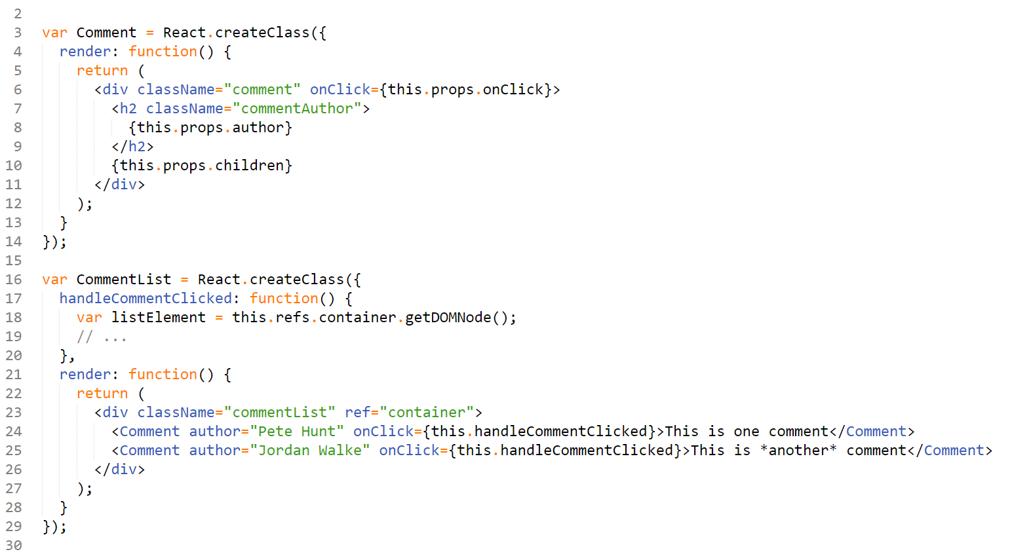
Component parts and composition
Notes:
COMPOSITION – Comments nested in the Comment component
PROPS – data propagation from the parent to child
PROPS.CHILDREN – propagation of the component content
Communication from the child to parent

Slide 19
REACT NATIVE

Slide 20
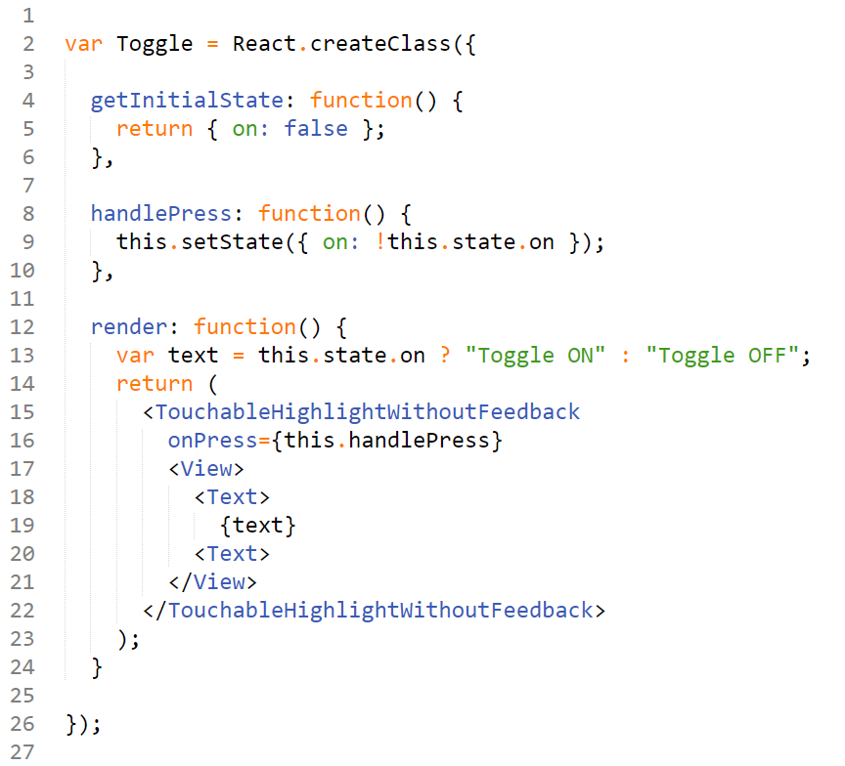
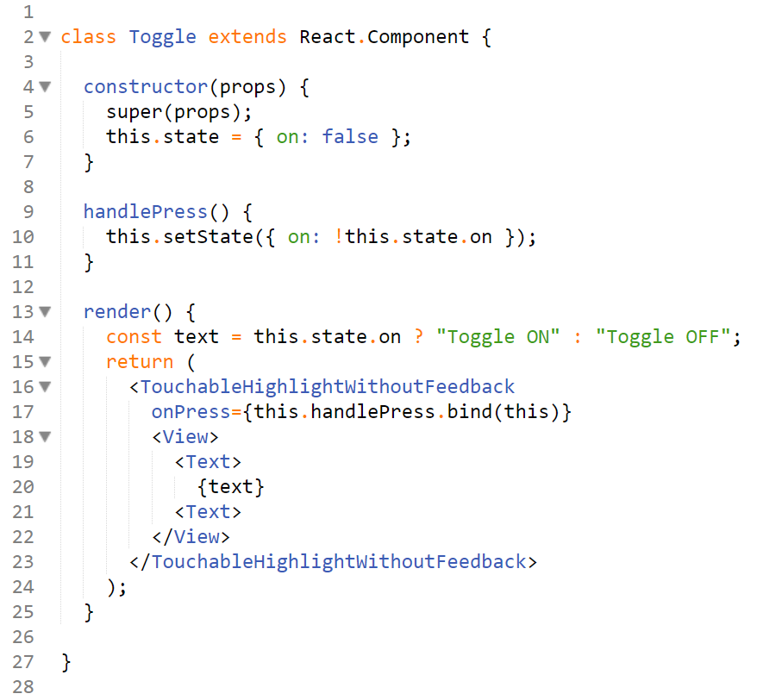
What does the component look in REACT NATIVE?
Older syntax
EcmaScript 2015 syntax
Notes:
RENDER method – renders native components
the rest of code is the same
instead of SPANS & DIVS we use TEXTS & VIEWS

Slide 21
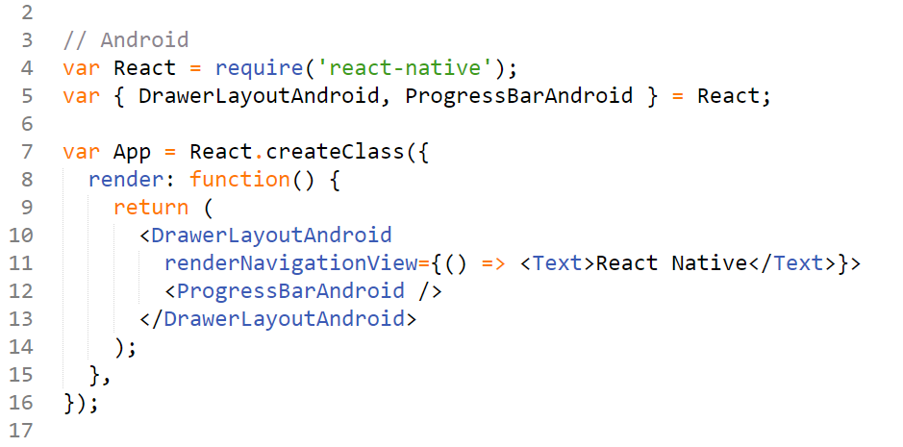
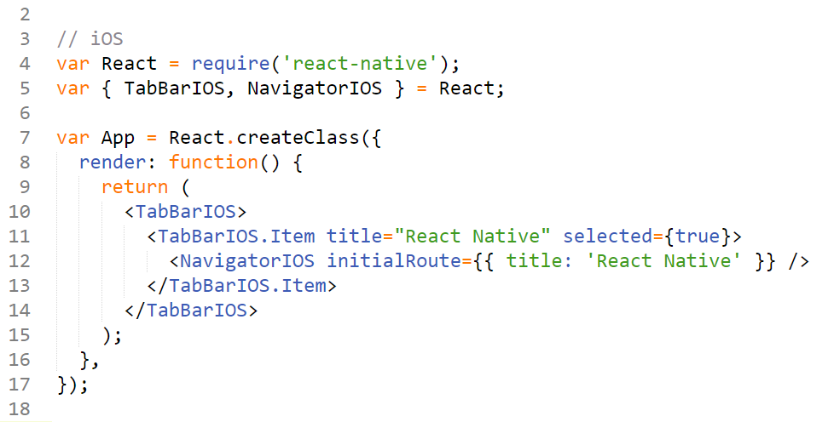
Native components
Notes:
RENDER method – renders native components
the rest of code is the same
not dependent on WebView

Slide 22
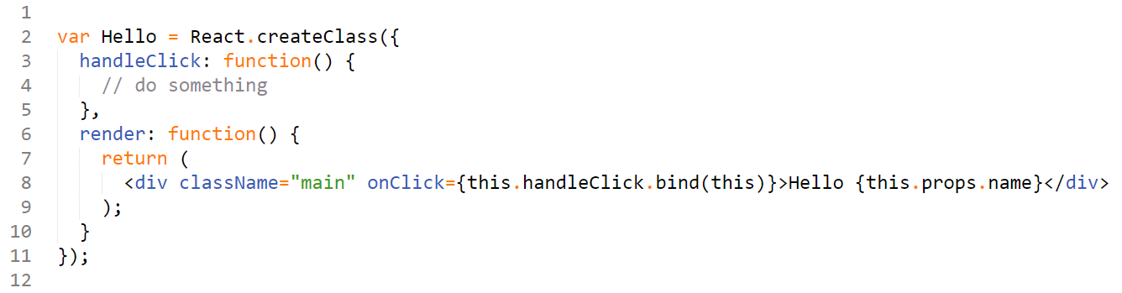
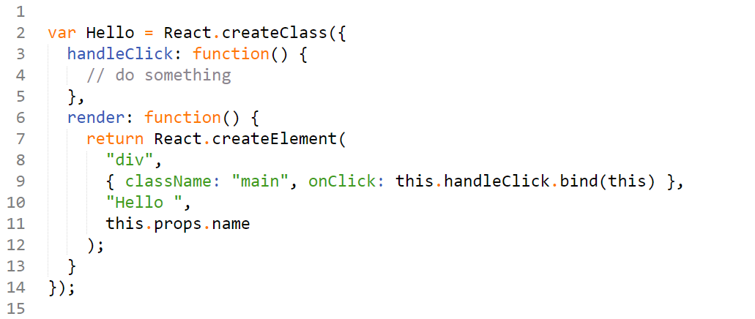
JSX transformation to JavaScript

Slide 23
How it works internally
small JavaScript code that controls native components

Slide 24
What do you get?
you don’t have to wait for compile times
Notes:
Developers can iterate more quickly, even javascript developers can make meaningful changes

Slide 25
What do you get?
you don’t have to wait for compile times
declarative way of defining components
Imperative – focuses on how the program operates
Declarative – focuses on what the program should accomplish
Notes:
Developers can iterate more quickly, even javascript developers can make meaningful changes

Slide 26
What do you get?
you don’t have to wait for compile times
declarative way of defining components
Imperative – focuses on how the program operates
Declarative – focuses on what the program should accomplish
code sharing between platforms
Notes:
Developers can iterate more quickly, even javascript developers can make meaningful changes

Slide 27
What do you get?
you don’t have to wait for compile times
declarative way of defining components
Imperative – focuses on how the program operates
Declarative – focuses on what the program should accomplish
code sharing between platforms
predictable – UI reflects the state
Notes:
Developers can iterate more quickly, even javascript developers can make meaningful changes

Slide 28
What do you get?
you don’t have to wait for compile times
declarative way of defining components
Imperative – focuses on how the program operates
Declarative – focuses on what the program should accomplish
code sharing between platforms
predictable – UI reflects the state
simplicity of JavaScript with high performant UI
Notes:
Developers can iterate more quickly, even javascript developers can make meaningful changes

Slide 29
What do you get?
easy to write tests
reuse components and their composition
reuse developers ☺
can be combined with other frameworks
easy debugging (Chrome/Safari dev tools, Chrome extension)
created by Facebook, strong community around
instant updates - CodePush, AppHub
app with native feel
Notes:
will be supported for a long time
fun to code

Slide 30
Let’s create an app

Slide 31
Environment setup
REACT REQUIREMENTS:
https://facebook.github.io/react-native/docs/getting-started.html#content
EDITOR:
Sublime - http://www.sublimetext.com/
Atom - https://atom.io/
FILES:
https://github.com/strvcom/React-Meetup.git
Notes:
will be supported for a long time
fun to code

Slide 32
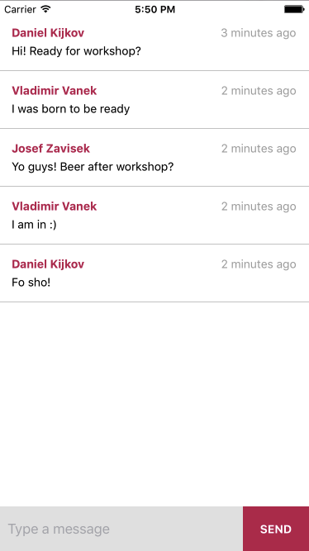
Chat app
Notes:
will be supported for a long time
fun to code

Slide 33
Chat app
Notes:
will be supported for a long time
fun to code

Slide 34
Notes:
will be supported for a long time
fun to code

